Slide 1
CSE 6040/x Programming Skills Office Hours
Week 1, Session 2

Slide 2
Agenda for This Week
Session 1
Code Efficiency and Readability
Function Development
Session 2
Python Loops
Comprehensions: Lists, Dicts, Sets
References and Copies
Troubleshooting Data for the Exams

Slide 3
Loops and Comprehensions
A for loop can iterate over every item in a list or go through every single character in a string and won't stop until it has gone through every character.
Writing for loops helps reduce repetitiveness in your code, following the DRY (Don't Repeat Yourself) principle. You don't write the same block of code more than once.
We can create new sequences using a given python sequence.
Can be done using loops
Can be done using Comprehensions (shorter way , but may take some time to get used to)
Comprehension is basically a way of writing a concise code block to generate a sequence which can be a list, dictionary, set by using another sequence
Note - Examples are in the accompanying notebook

Slide 4
Comprehensions pros and cons
Using loops is okay. However, it is worth understanding comprehensions because they have their own benefits.
Pros:
Generally faster than for loops, especially for large datasets.
Takes less code to write and fits in a smaller space than a for loop.
Cons:
Can be less legible in certain situations.
Can be harder to implement for complicated operations in for loops.
As you progress through the course, you will see problem solutions that use comprehensions whenever possible which will enable you to wrap your head around them.
Advice – Always pause and think if you can use a comprehension instead of a loop. Practice, Practice, Practice!!!

Slide 5
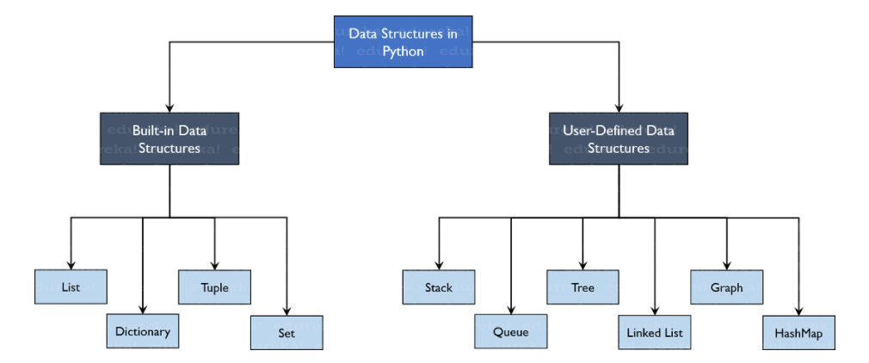
Python Data Structures
Data Structures allows you to organize your data in such a way that enables you to store collections of data, relate them and perform operations on them accordingly.

Slide 6
Operations on data structures
List
Dictionary
Set
extend()
insert()
append()
remove()
pop()
slice
reverse()
min() & max()
sort()
index()
items()
keys()
values()
union()
intersection()
difference()
add()
remove()

Slide 7
Open Discussion / Q&A

